Slide 1


Administrative Review (AR)
For
Contracting Entities
Corrective Action Documents (CAD)
Notes:
Welcome to The Texas Department of Agriculture’s Administrative Review in TX-UNPS, specifically focusing on Corrective Action Documents.

Slide 2

ICON | FUNCTION
 | ATTACHMENT: Select this icon beside the corresponding question to upload a file as an attachment.
 | ERROR: Indicates that a question is in is error. The error process is initiated once a user selects the Validate button at the bottom of the form page. The form will remain in an error status until all required questions have been answered
 | TOOL TIP: Hovering over the icon will briefly display additional information that may aid in answering the review question. The user can also click the icon to display the information in a popup.
!
?
WORDS | DEFINITION
VIEW | View only, no changes are possible
MODIFY | Edit, make changes
DETAIL | Opens selected parts of the review
AGENCY | Contracting Entity
Notes:
The following icons are used in the Administrative review module. Please take a few moments to familiarize yourself with them.
Throughout the AR module you will often see the word ‘AGENCY’ . Agency means Contracting Entity.
ATTACHMENT: Select this icon beside the corresponding question to upload a file as an attachment
ERROR: Indicates that a question is in is error. The error process is initiated once a user selects the Validate button at the bottom of the form page. The form will remain in an error status until all required questions have been answered
TOOL TIP: Hovering over the icon will briefly display additional information that may aid in answering the review question. The user can also click the icon to display the information in a popup.
VIEW: View only, no changes are possible
MODIFY: Edit, make changes
DETAIL: Opens selected parts of the review
AGENCY: Contracting Entity

Slide 3
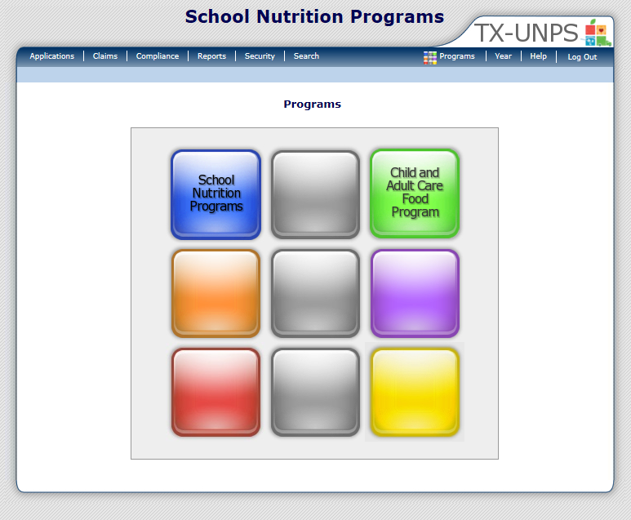
Notes:
After you have logged into the system, click on ‘COMPLIANCE ‘ on the blue navigation menu bar

Slide 4
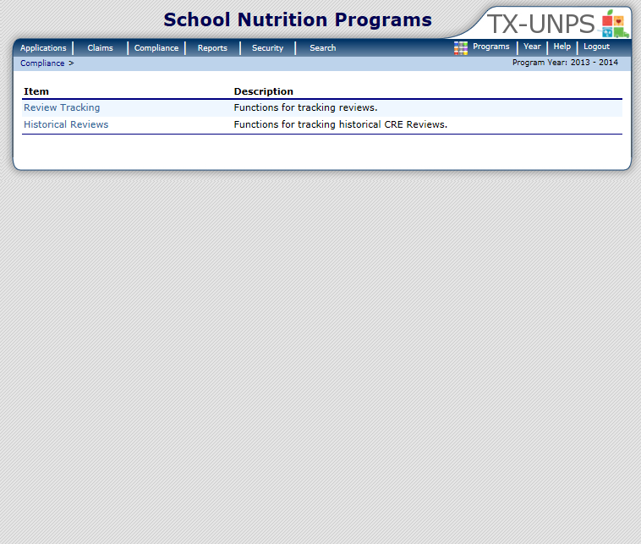
Notes:
Next, select ‘REVIEW TRACKING’

Slide 5
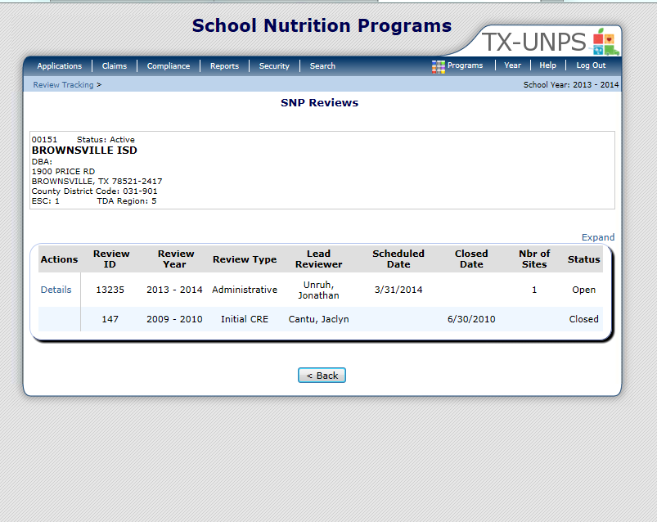
Notes:
This will open up the SNP Review screen
Only Reviews that have a status of Open are accessible. Click ‘DETAILS’

Slide 6

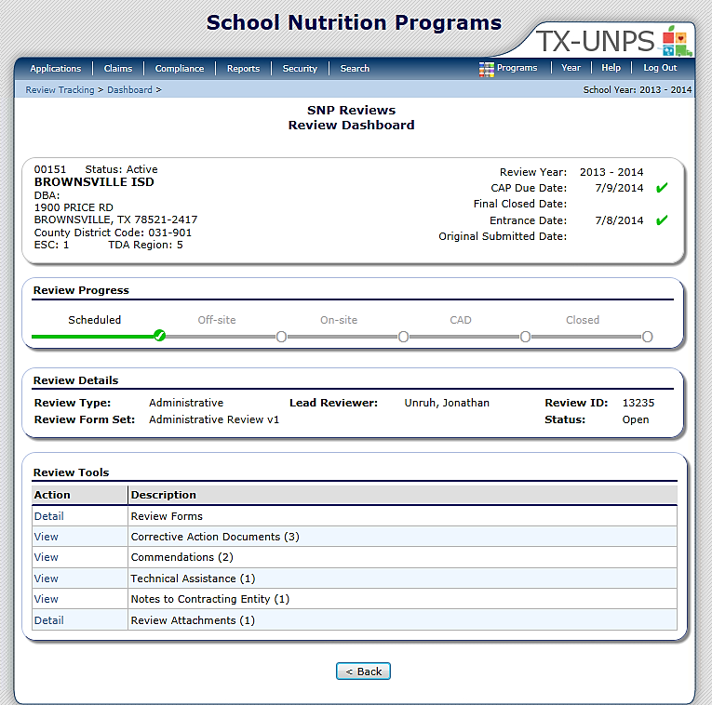
01234 Status: Active
ANYWHERE ISD
DBA:
1 Main ST
Anywhere, US 12345
County District Code : 123-456
ESC Region: 1
SCHOOL
INFORMATION:
IMPORTANT
DATES:
Notes:
The next screen is the Review Dashboard
The Review Dashboard serves as the launching point for all information pertaining to the review.
At the top of the page you will see a box that has basic information:
On the left is the school’s basic information (name, address and ESC region)
On the right are important dates (Review year, CAP due date, Final closed date, Entrance date and original submitted date).
Below this box is the REVIEW PROGRESS box. The review progress bar enables you to view the stage of the review at–a-glance. Each stage must be completed sequentially in order to progress through the review process
The last box contains the REVIEW TOOLS. This is where you will navigate to specific sections or modules of the review.

Slide 7

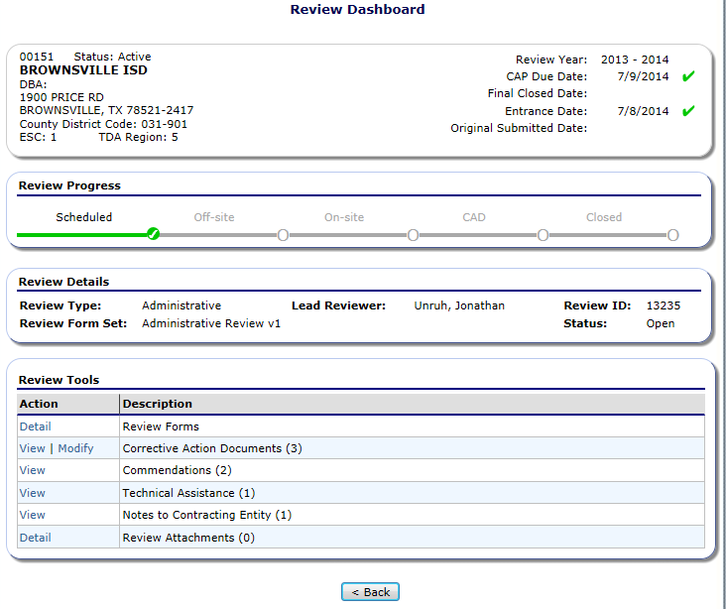
01234 Status: Active
ANYWHERE ISD
DBA:
1 Main ST
Anywhere, US 12345
County District Code : 123-456
ESC Region: 1
Notes:
You can access the ‘CORRECTIVE ACTION DOCUMENTS’ from the Review Dashboard. To open, select ‘MODIFY’

Slide 8
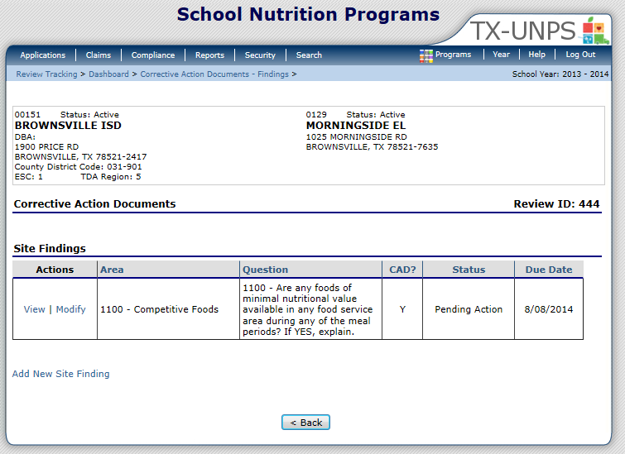
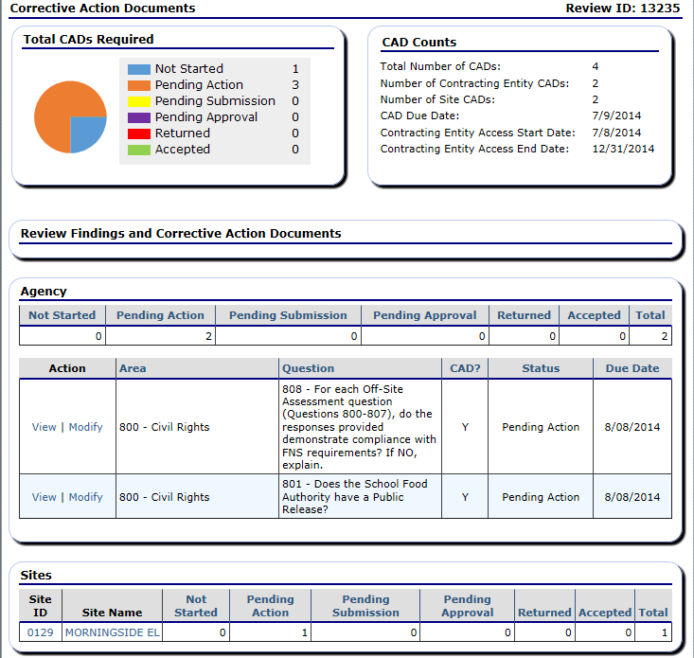
01234 Status: Active
ANYWHERE ISD
DBA:
1 Main ST
Anywhere, US 12345
County District Code : 123-456
ESC Region: 1
Notes:
CORRECTIVE ACTION DOCUMENTS
Total CADs Required: Visual Aid – pie chart: Shows the status of findings in the CAD
CAD Counts:
Here you see the Total Number of CADs, The number of CE CADs, Number of Site CADs
You will also find the important dates here such as: the CAD Due Date and the CE Access start and end date
Agency, or Contracting Entity Level CADs are listed next.
In the first box is a summary of the CADs; they include:
Not Started
Pending Action: The CE must complete an action
Pending Submission
Pending Approval
Returned
Accepted
Total
Beneath that each CAD is listed with individual details. To open up a CAD, Click ‘VIEW’
Next are the SITE CADs
Each site that has a CAD will be listed. To view the details for a specific site click on the name of the site. You will then see the details for the site you selected.

Slide 9
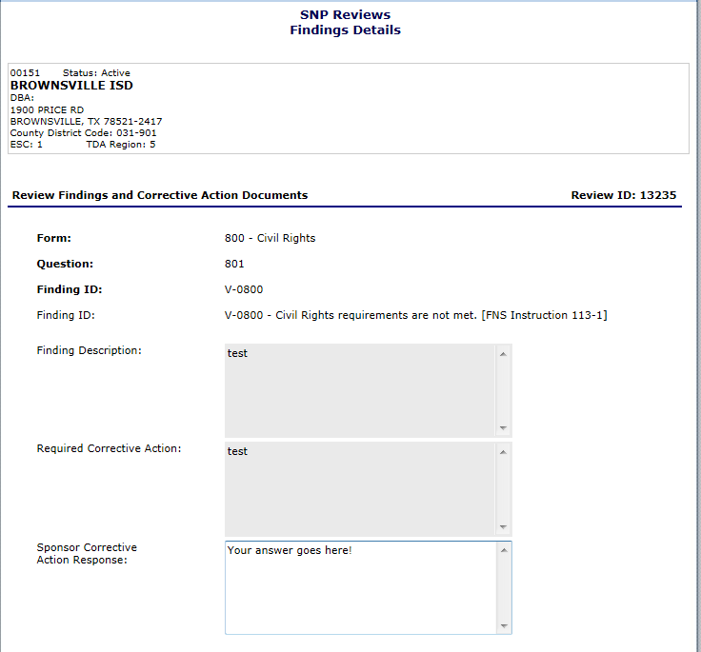
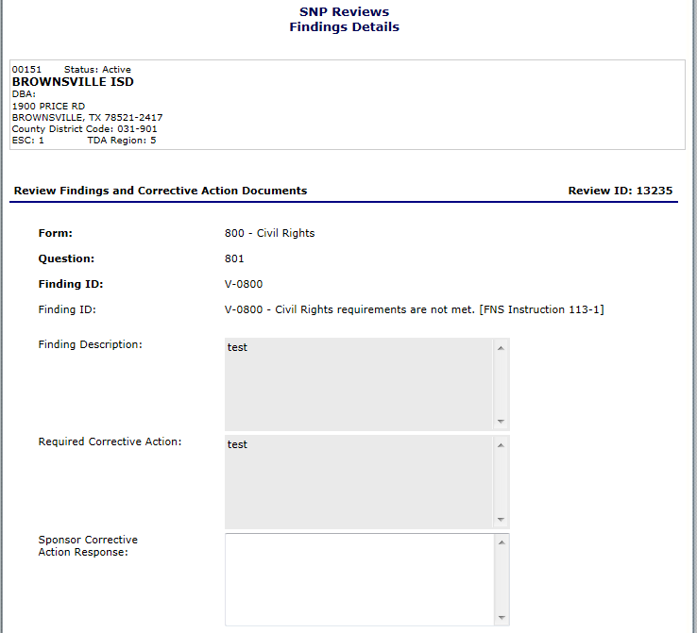
01234 Status: Active
ANYWHERE ISD
DBA:
1 Main ST
Anywhere, US 12345
County District Code : 123-456
ESC Region: 1
Notes:
Once you open a finding (CE or Site level) you will see basic information for your reference about the finding:
Form: Indicates the area of the review a CAD finding was identified
Finding ID: Indicates what requirement was not met during the review
Next is a detailed description of the finding identified during the review process.
The required Corrective Action Box provides you instructions on what information and documentation must be provided with your response to the CAD findings
The last box is for you to provide a response for the corrective action

Slide 10
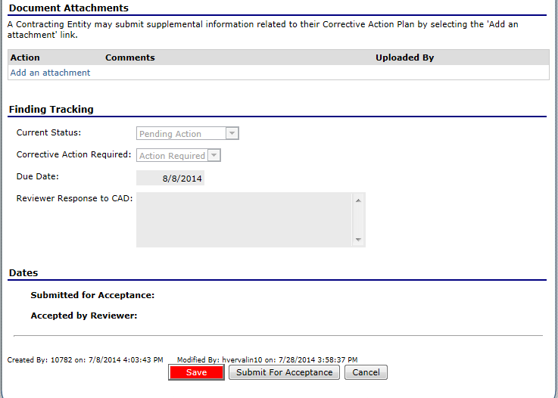
Notes:
Document Attachments
It may be necessary for you to attach a document as supporting evidence

Slide 11
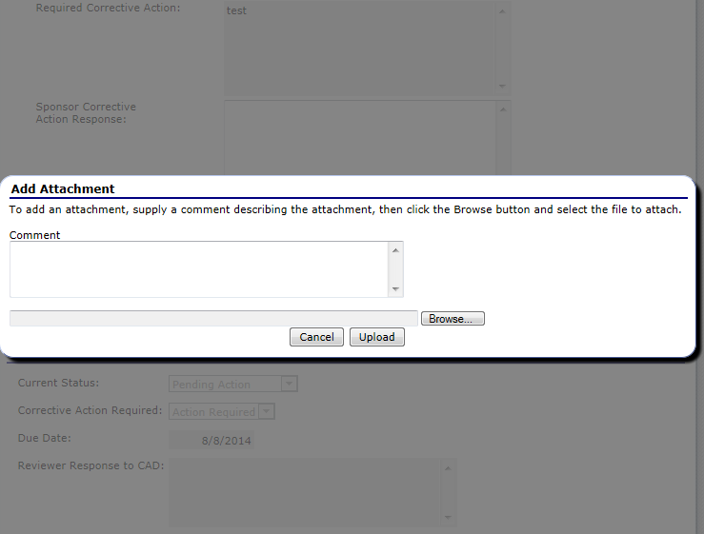
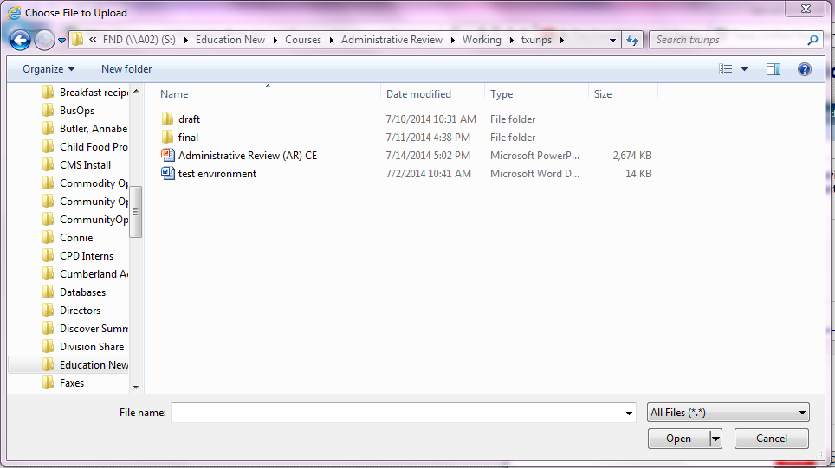
This is my brief description
test environment
Notes:
Type a brief comment describing the attachment
Next, select ‘BROWSE’
This will open up a list of files on your computer that you can attach. Select the file you that you want to attach and click ‘OPEN’

Slide 12
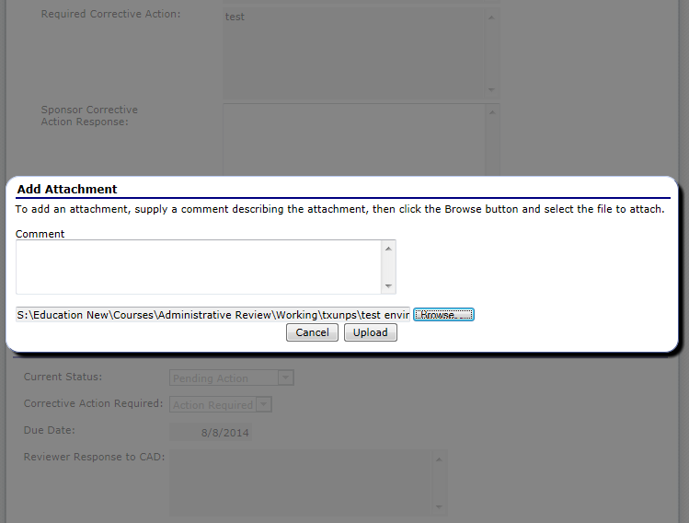
This is my brief description
Notes:
Once your document is listed in the browse box, select ‘UPLOAD’

Slide 13
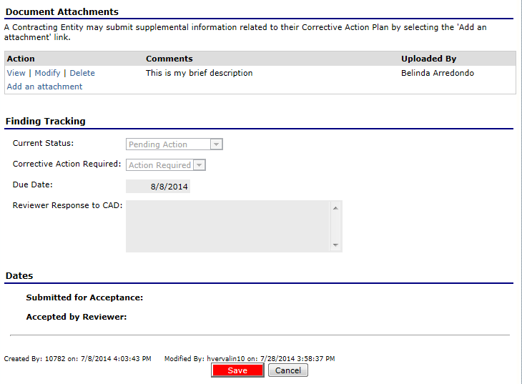
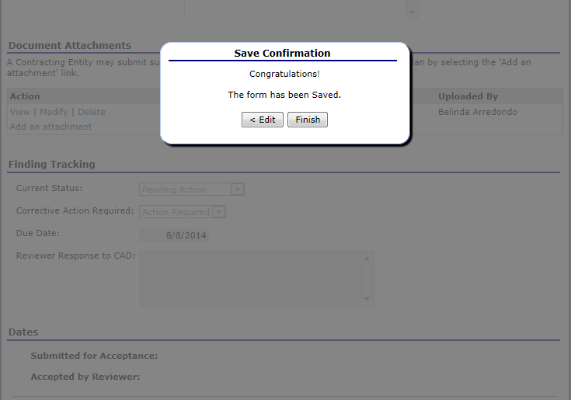
Notes:
You will now see this document listed in the Document Attachments section.
Select ‘SAVE’
Next select ‘FINISH’

Slide 14
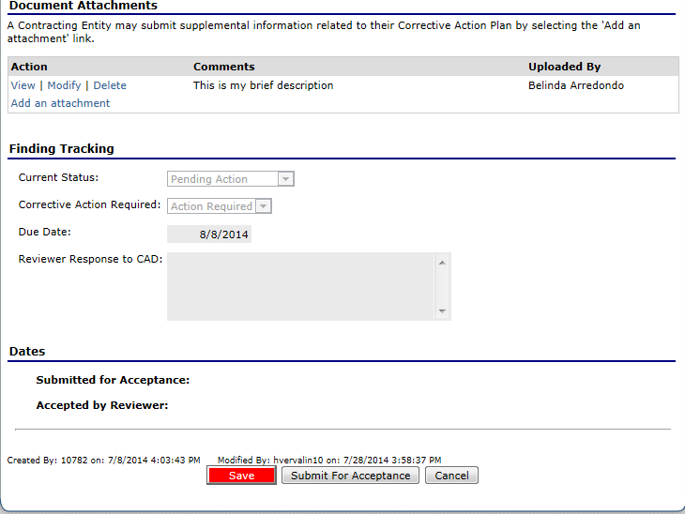
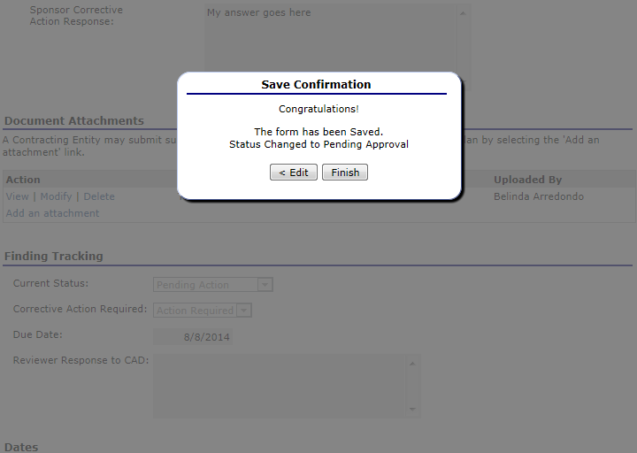
Notes:
The Final step is to ‘SUBMIT FOR ACCEPTANCE’
You will receive the Save Confirmation message, select ‘FINISH’

Slide 15
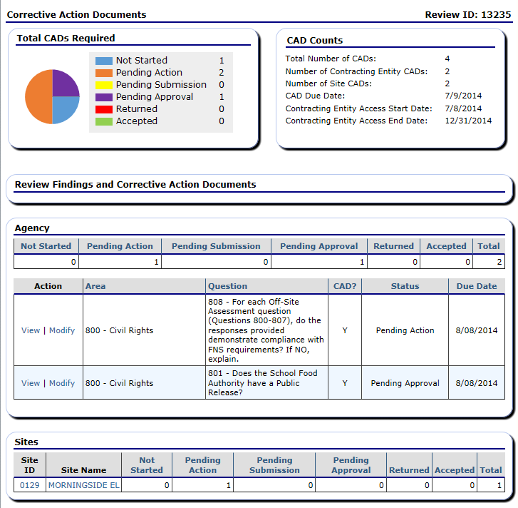
Notes:
You will now notice the status has changed to ‘PENDING APPROVAL’
And the Total CADs Required pie chart has also change to reflect the new status.

Slide 16


In accordance with Federal civil rights law and U.S. Department of Agriculture (USDA) civil rights regulations and policies, the USDA, its Agencies, offices, and employees, and institutions participating in or administering USDA programs are prohibited from discriminating based on race, color, national origin, sex, disability, age, or reprisal or retaliation for prior civil rights activity in any program or activity conducted or funded by USDA.
Persons with disabilities who require alternative means of communication for program information (e.g. Braille, large print, audiotape, American Sign Language, etc.), should contact the Agency (State or local) where they applied for benefits. Individuals who are deaf, hard of hearing or have speech disabilities may contact USDA through the Federal Relay Service at (800) 877-8339. Additionally, program information may be made available in languages other than English.
To file a program complaint of discrimination, complete the USDA Program Discrimination Complaint Form, (AD-3027) found online at: How to File a Complaint, and at any USDA office, or write a letter addressed to USDA and provide in the letter all of the information requested in the form. To request a copy of the complaint form, call (866) 632-9992. Submit your completed form or letter to USDA by:
mail:
U.S. Department of Agriculture
Office of the Assistant Secretary for Civil Rights
1400 Independence Avenue, SW
Washington, D.C. 20250-9410;
fax: (202) 690-7442; or email: program.intake@usda.gov.
This institution is an equal opportunity provider.
TEXAS DEPARTMENT OF AGRICULTURE
COMMISSIONER SID MILLER
Food and Nutrition Division
National School Lunch Program
This product was funded by USDA.
This institution is an equal opportunity provider.
Updated 12/22/2020
www.SquareMeals.org

